Slide 2
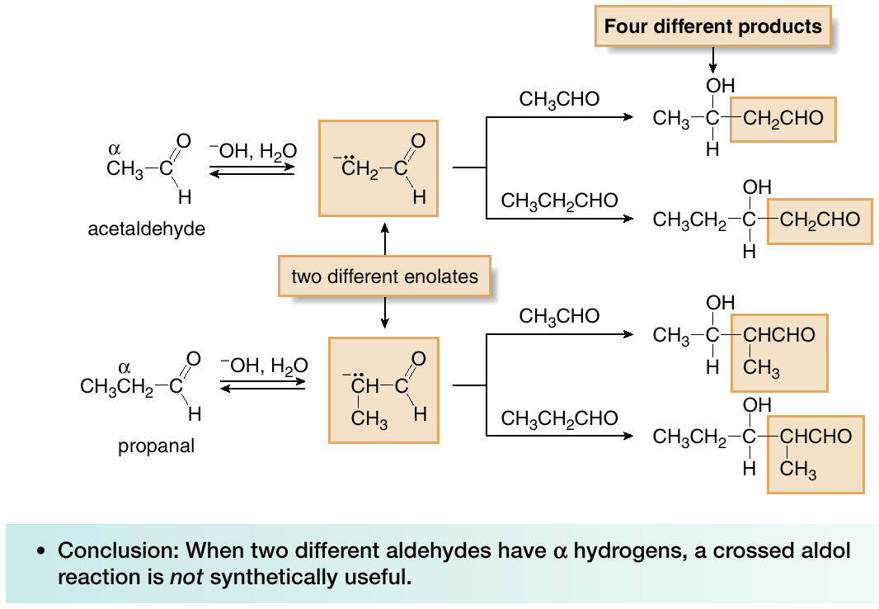
Carbonyl Condensation Reactions
Crossed Aldol Reactions
Sometimes it is possible to carry out an aldol reaction between two different carbonyl compounds. Such reactions are called crossed or mixed aldol reactions.

Slide 3
Carbonyl Condensation Reactions
Crossed Aldol Reactions
Crossed aldols are synthetically useful in two different situations:
[1] When only one carbonyl component has α hydrogens—such cases often lead to the formation of only one product.

